Slide 1
Neural Translation - Transformer
Pattern Recognition & Machine Learning Laboratory
Ji-Sang Hwang, Aug 5, 2021

Slide 2
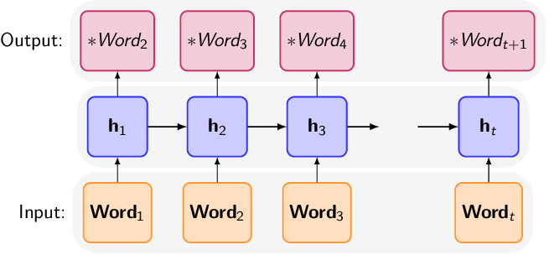
Attention is All You Need [A. Vaswani et al., 2017] (1/9)
Introduction
Recurrent model
Having been firmly established as state-of-the-art approach in sequence modeling and transduction problems
Factoring computation along the symbol positions of the input and output sequences
Precluding parallelization within training examples because of inherently sequential nature
Attention mechanisms
Becoming an integral part of compelling sequence modeling and transduction models in various tasks
Allowing modeling of dependencies without regard to their distance in the input or output sequences [Y. Kim, 2017]
Goal
A model architecture eschewing recurrence
Relying entirely on an attention mechanism
to draw global dependencies between input
and output
Architectures of RNN
Y. Kim et al., “Structured attention networks”, ICLR, 2017

Slide 3
Attention is All You Need [A. Vaswani et al., 2017] (2/9)
Background
Reducing sequential computation
Using convolutional neural networks (CNN) as basic building block
Computing hidden representations in parallel for all input and output positions
The number of operations required to relate signals from two arbitrary input or output positions grows in the distance between postions
ConvS2S : Linearly [J. Gehring et al., 2017]
ByteNet : Logarithmically [N. Kalchbrenner et al., 2017]
Self-Attention [Z. Lin et al., 2017]
Relating different positions of a single sequence in order to compute a representation of the sequence
Used successfully in a variety of tasks
End-to-end memory networks [S. Sukhbaatar et al., 2015]
Based on a recurrent attention mechanism instead of sequence-aligned recurrence
Shown to perform well on simple-language question answering and language modeling tasks
J. Gehring et al., “Convolutional sequence to sequence learning”, ICLR, 2017.
N. Kalchbrenner et al., “Neural machine translation in linear time”, arXiv, 2016.
Z. Lin et al., “A structured self-attentive sentence embedding”, arXiv, 2017.
S. Sukhbaatar et al., “End-to-end memory networks”, arXiv, 2015.

Slide 4

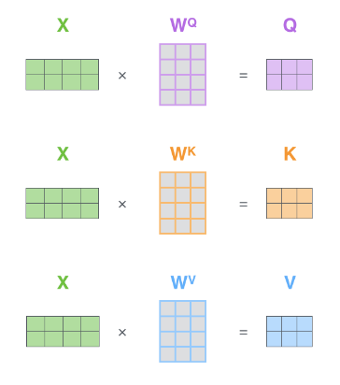
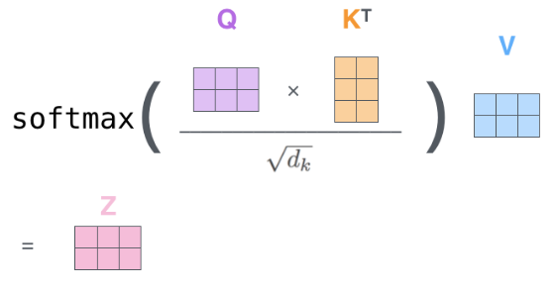
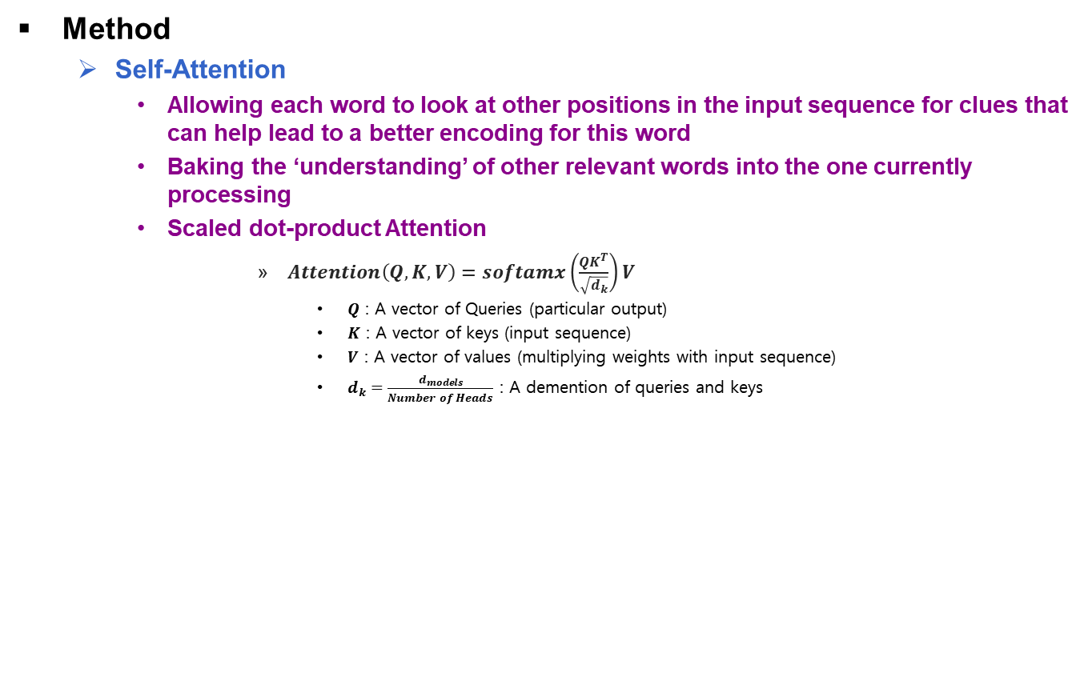
Attention is All You Need [A. Vaswani et al., 2017] (3/9)
Method
Self-Attention
Allowing each word to look at other positions in the input sequence for clues that can help lead to a better encoding for this word
Baking the ‘understanding’ of other relevant words into the one currently processing
Scaled dot-product Attention
$Attention\left(Q, K, V\right)=softamx\left(\frac{QK^{T}}{\sqrt{d_{k}}}\right)V$
$Q$ : A vector of Queries (particular output)
$K$ : A vector of keys (input sequence)
$V$ : A vector of values (multiplying weights with input sequence)
$d_{k}=\frac{d_{models}}{Number of Heads}$ : A demention of queries and keys
Embedding
Weight Vector
Queries
Keys
Values
Example of understanding
Image of Calculation Scaled-Dot-Product Attention

Slide 5
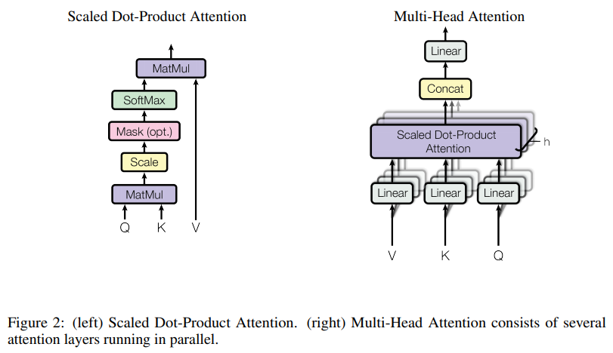
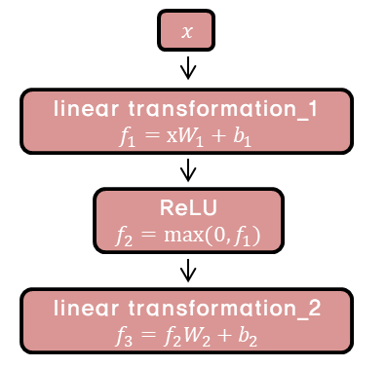
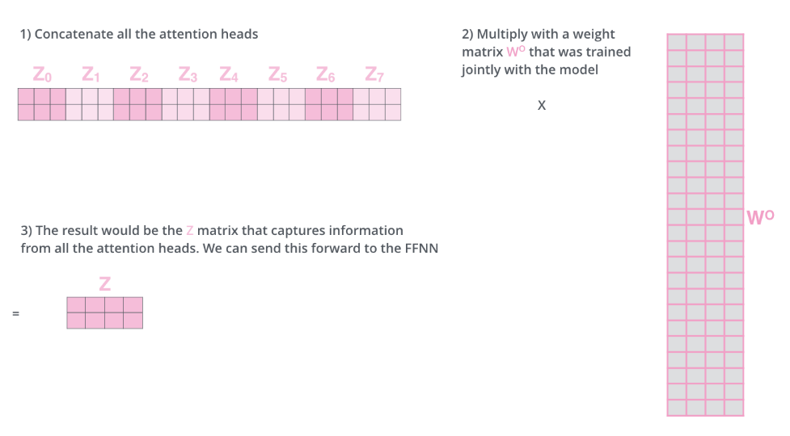
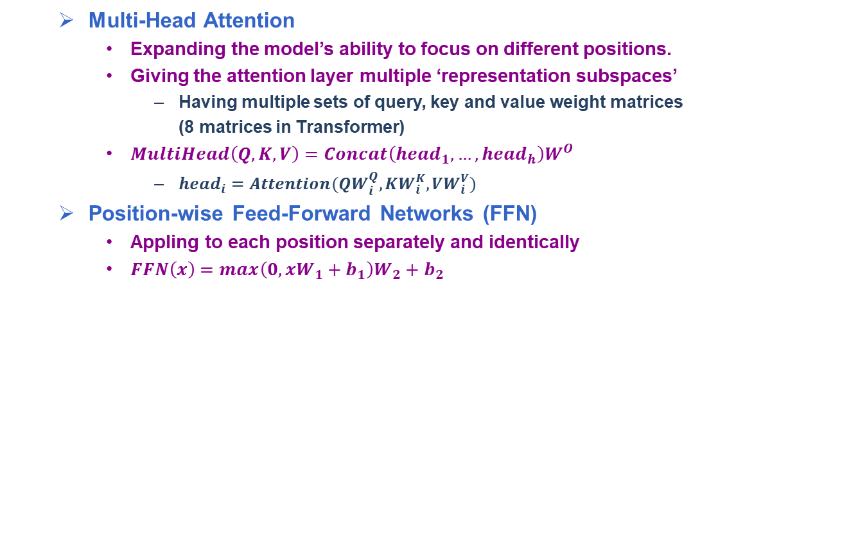
Attention is All You Need [A. Vaswani et al., 2017] (4/9)
Multi-Head Attention
Expanding the model’s ability to focus on different positions.
Giving the attention layer multiple ‘representation subspaces’
Having multiple sets of query, key and value weight matrices
(8 matrices in Transformer)
$MultiHead\left(Q,K,V\right)=Concat\left({head}_{1},…,{head}_{h}\right)W^{O}$
${head}_{i}=Attention(QW_{i}^{Q},KW_{i}^{K},VW_{i}^{V})$
Position-wise Feed-Forward Networks (FFN)
Appling to each position separately and identically
$FFN\left(x\right)=max\left(0,xW_{1}+b_{1}\right)W_{2}+b_{2}$
Architecture of Multi-Head Attention
Sequence of Multi-Head Attention
Architecture of Position-wise FFN

Slide 6
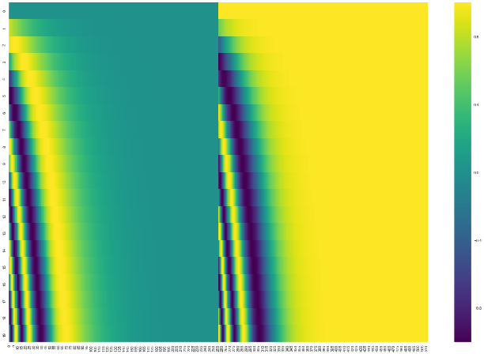
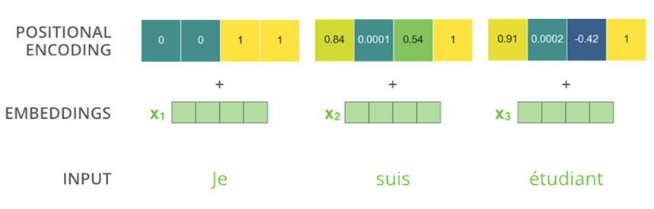
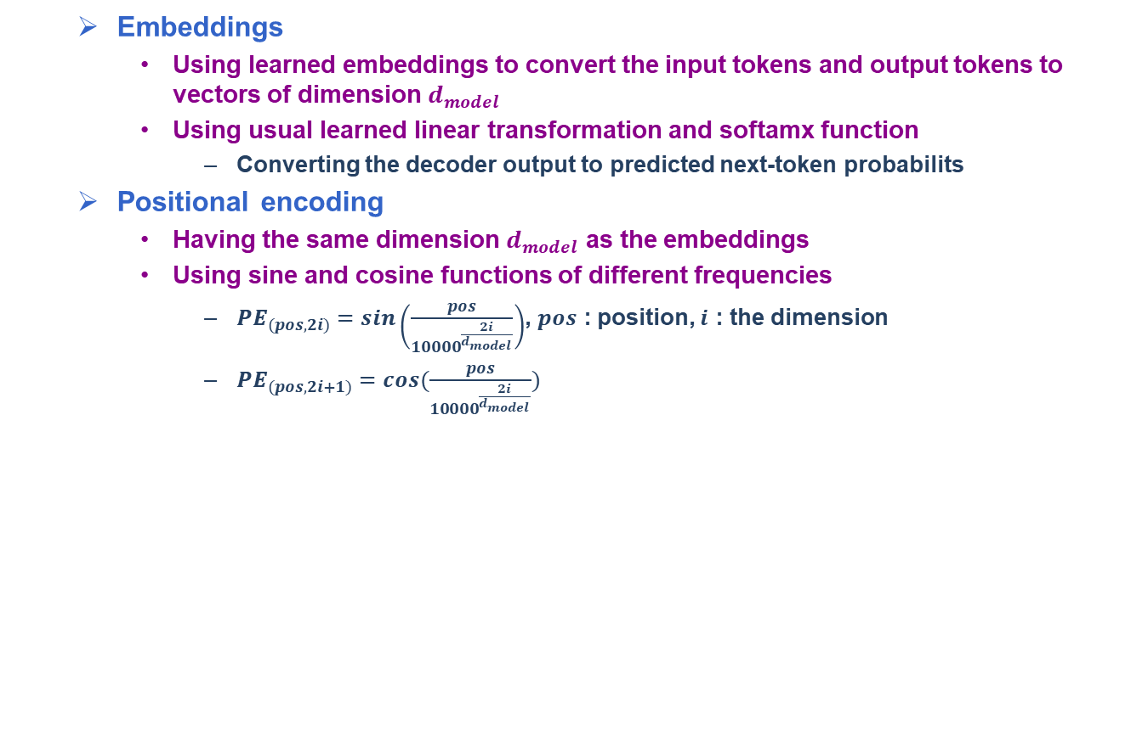
Attention is All You Need [A. Vaswani et al., 2017] (5/9)
Embeddings
Using learned embeddings to convert the input tokens and output tokens to vectors of dimension $d_{model}$
Using usual learned linear transformation and softamx function
Converting the decoder output to predicted next-token probabilits
Positional encoding
Having the same dimension $d_{model}$ as the embeddings
Using sine and cosine functions of different frequencies
${PE}_{(pos, 2i)}=sin\left(\frac{pos}{{10000}^{\frac{2i}{d_{model}}}}\right)$, $pos$ : position, $i$ : the dimension
${PE}_{(pos, 2i+1)}=cos(\frac{pos}{{10000}^{\frac{2i}{d_{model}}}})$
Example Positional encoding
Example of Embeddings and Positional encoding

Slide 7
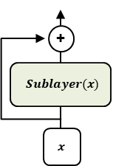
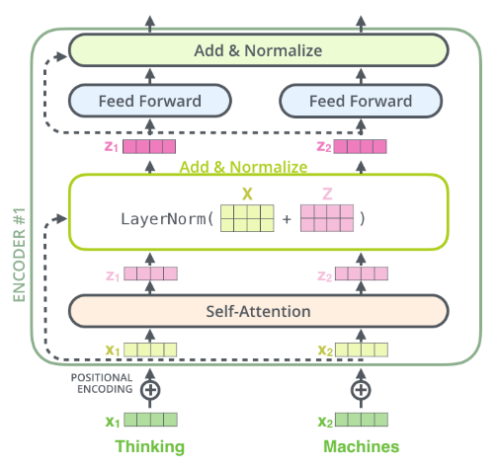
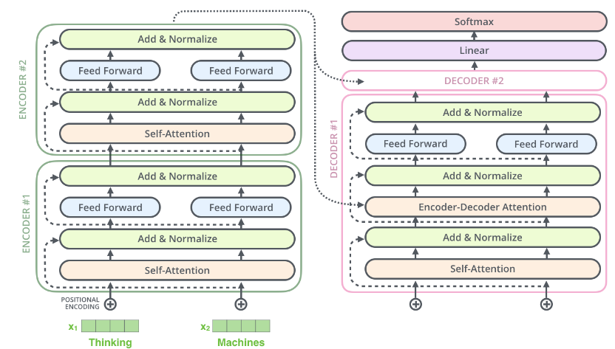

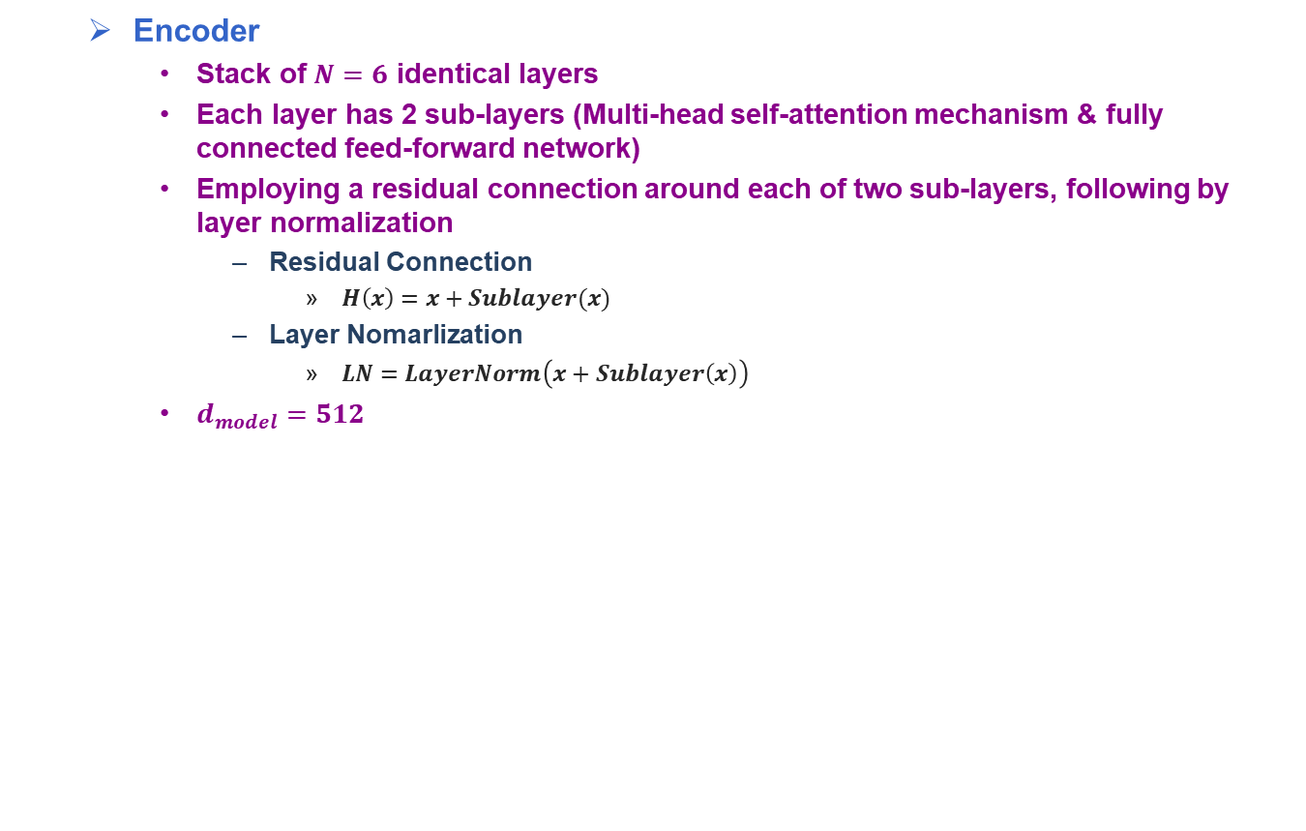
Attention is All You Need [A. Vaswani et al., 2017] (6/9)
Encoder
Stack of $N=6$ identical layers
Each layer has 2 sub-layers (Multi-head self-attention mechanism & fully connected feed-forward network)
Employing a residual connection around each of two sub-layers, following by layer normalization
Residual Connection
$H\left(x\right)=x+Sublayer(x)$
Layer Nomarlization
$LN=LayerNorm\left(x+Sublayer\left(x\right)\right)$
$d_{model}=512$
Example of Residual Connection
Detail architecture of Encoder to Decoder
Example of Encoder to Decoder

Slide 8
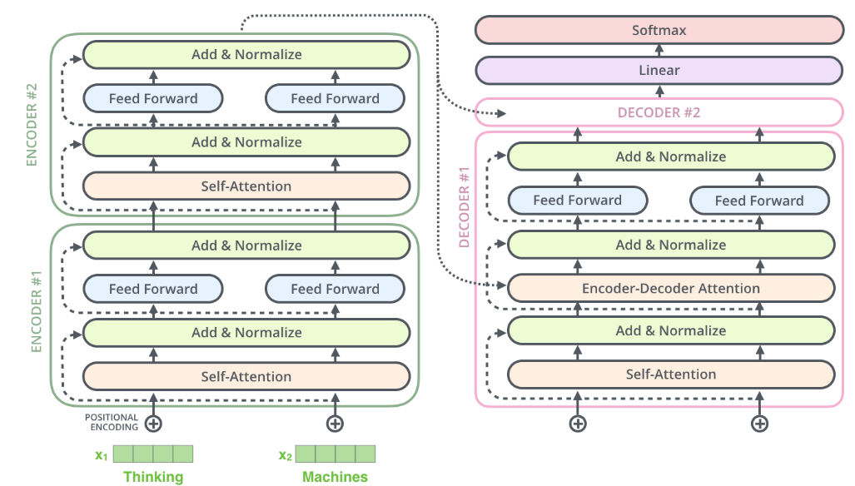

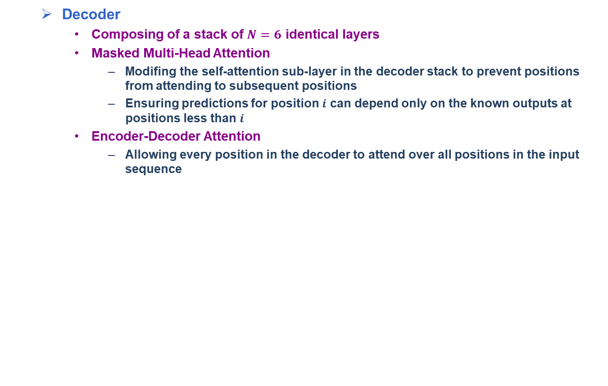
Attention is All You Need [A. Vaswani et al., 2017] (7/9)
Decoder
Composing of a stack of $N=6$ identical layers
Masked Multi-Head Attention
Modifing the self-attention sub-layer in the decoder stack to prevent positions from attending to subsequent positions
Ensuring predictions for position $i$ can depend only on the known outputs at positions less than $i$
Encoder-Decoder Attention
Allowing every position in the decoder to attend over all positions in the input sequence
Detail architecture of Encoder
Example of Decoder

Slide 9

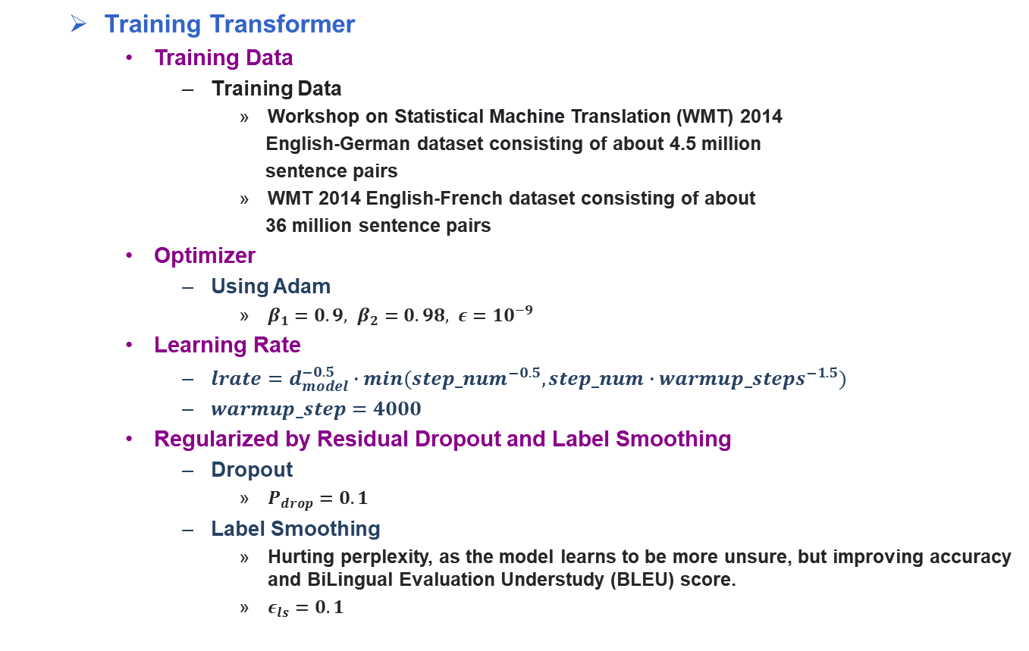
Attention is All You Need [A. Vaswani et al., 2017] (8/9)
Training Transformer
Training Data
Training Data
Workshop on Statistical Machine Translation (WMT) 2014
English-German dataset consisting of about 4.5 million
sentence pairs
WMT 2014 English-French dataset consisting of about
36 million sentence pairs
Optimizer
Using Adam
$β_{1}=0.9, β_{2}=0.98, ε={10}^{−9}$
Learning Rate
$lrate=d_{model}^{−0.5}∙min({step_num}^{−0.5},step_num∙{warmup_steps}^{−1.5})$
$warmup_step=4000$
Regularized by Residual Dropout and Label Smoothing
Dropout
$P_{drop}=0.1$
Label Smoothing
Hurting perplexity, as the model learns to be more unsure, but improving accuracy and BiLingual Evaluation Understudy (BLEU) score.
$ε_{ls}=0.1$
Architecture of Transformer

Slide 10
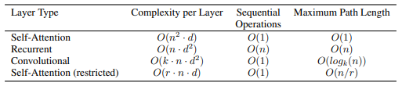

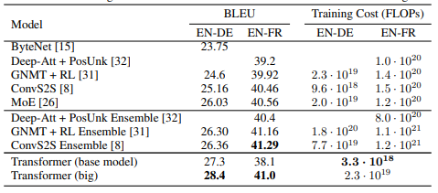
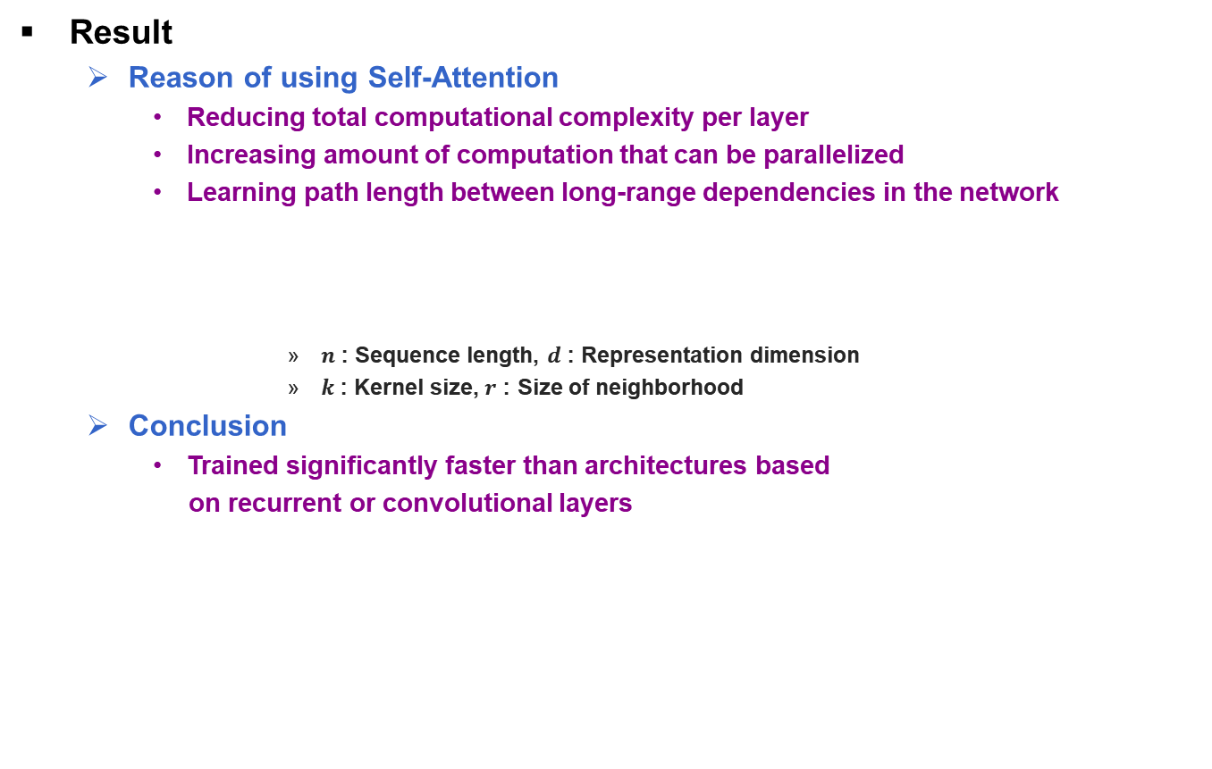
Attention is All You Need [A. Vaswani et al., 2017] (9/9)
Result
Reason of using Self-Attention
Reducing total computational complexity per layer
Increasing amount of computation that can be parallelized
Learning path length between long-range dependencies in the network
$n$ : Sequence length, $d$ : Representation dimension
$k$ : Kernel size, $r$ : Size of neighborhood
Conclusion
Trained significantly faster than architectures based
on recurrent or convolutional layers
Table of Complexity
Table of Machine Performance in WMT 2014
Visualization of Machine Translation

